Slide 1
Atypical Spinal Cord Tumors: When Expect the Unexpected?
Authors: Scoppetta TLD, Assunção FB, Freitas LF, Martins LA, Silva GDA, Calixto NC, Maruyama FN, Scoppetta LCD.
From Department of Neurorradiogy and Head and Neck of Hospital São Camilo
Notes:
Escrever texto

Slide 2
Content
How are we going to approach this subject?
1) Introduction
2) Cases presentation
3) Algoritm
4) Conclusion
5) References

Slide 3
Introduction
Spinal cord tumors (SCT) are uncommon lesions and correspond to 5-12% of primary CNS tumors [1]. Their classic clinical manifestation is the insidious onset of vaguely localized spinal pain. Sensory and motor deficit are variable, occurring in function of tumor localization [1, 2].
Despite their rarity, they represent a challenge for patients and neurosurgeons due to the high risk of neurological deficits resulting from the disease process and surgical interventions.
Magnetic resonance imaging (MRI) plays a central role in the assessment of spinal tumors, as it allows the location of the lesion, assessment of its characteristics and extension and relationship with regional structures.
Spinal tumors are divided by their location:
Extradural tumors: The majority of spinal tumors (60% of all spinal tumors) in adults are extradural tumors and are most commonly metastases of systemic neoplasms.
Intradural - extramedullary tumors: Second most common spinal tumors in adults (20%-30%), mainly represented by meningioma or peripheral nerve sheath tumors (schwannomas)
Intramedullary tumors: The least common spinal tumor type in adults but the most common spinal tumors in children. Ependymomas and astrocytomas corresponds to 70% of intramedullary tumors.

Slide 4
INTRADURAL
EXTRAMEDULLARY
INTRAMEDULLARY
EXTRADURAL
Dural sac spinal
Spinal Cord
Tumor

Slide 5
Introduction
Although non-specific, MRI features can help radiologists provide a reasonable differential diagnosis for spinal neoplasms, favoring the most common hypotheses based on tumor location and appearance, or identifying radiological features that may point to a less common entity.
For this, a systematic analysis of MR images must be performed, and radiologists must be able to classify the lesion in its compartment of origin (i.e., intra x extradural), evaluate the morphology and extension of the lesions, signal intensity abnormalities, presence of enhancement after contrast medium administration and relationship with neighboring structures. Furthermore, to assess the association with the presence of hemorrhage, cystic changes or calcifications and to correlate the findings with the patient's clinical context
The objective of this scientific poster is to illustrate the atypical presentation of spinal tumors and identify and describe possible tips for their recognition by imaging when possible.

Slide 6
Atypical presentations
INTRAmedullary tumors that are typically EXTRAmedullary
INTRAmedullary metastases. These are more commonly found in BONE structures
GIANT tumors that are generally smaller and without bone involvement
Spinal astrocytomas exhibiting heterogeneous signal and cystic component.
Intramedullary tumors that typically involve long segments, have eccentric location and patchy enhancement
Intradural Lesions that habitually involve bone structures

Slide 7
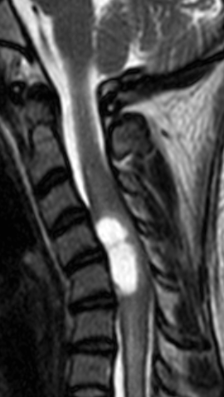
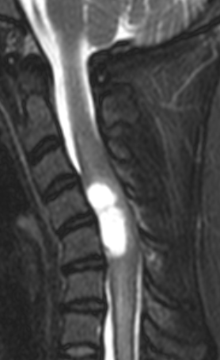
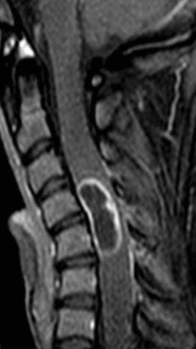
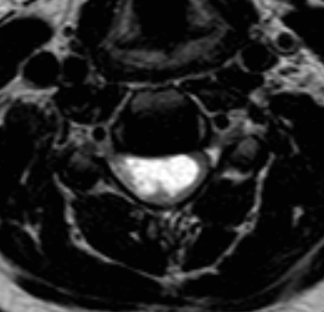
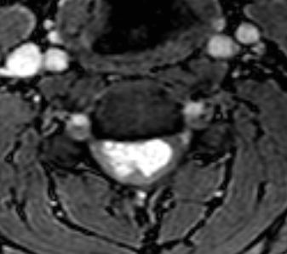
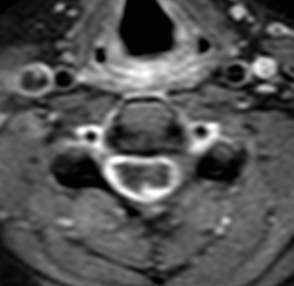
INTRAmedullary tumors that are typically EXTRAmedullary
Intramedullary Schwannoma
Most spinal schwannomas are intradural and extramedullary. Intramedullary Schwannomas (IS) are rare, accounting for 1.1% of spinal schwannomas and 0.3% of intraspinal tumors. The most common location of IS is cervical spine (63%), thoracic (26%) and lumbar (11%) levels [3].
MRI features are not specific but IS are most commonly iso/hypointense on T1- weighted mages, moderately hyperintense on T2-weighted images; usually with intense contrast enhancement [4]. MR imaging signal intensity depends on different macroscopic features (solid or cystic components) or histological composition. (Fig. 1).
More usually ISs are well marginated, and perilesional edema is moderate. Syringomyelia is not common.
Contrast-enhanced images help delineate the lesion and differentiate solid from cystic components, syringomyelia and oedema [5].
Presence of predominant extramedullary component or intramedullary tumor continuity with a thickened spinal nerve root may suggest the diagnosis of IS.
Fig 1. Intramedullary Schwannoma

Slide 8
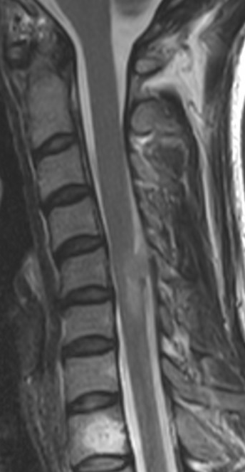
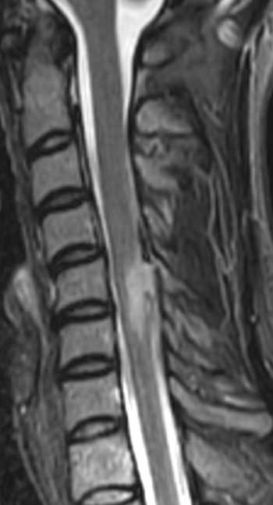
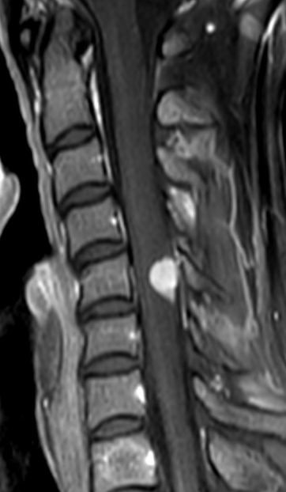
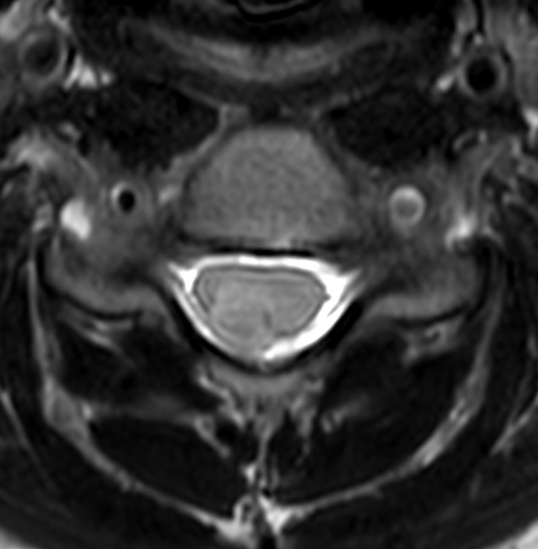
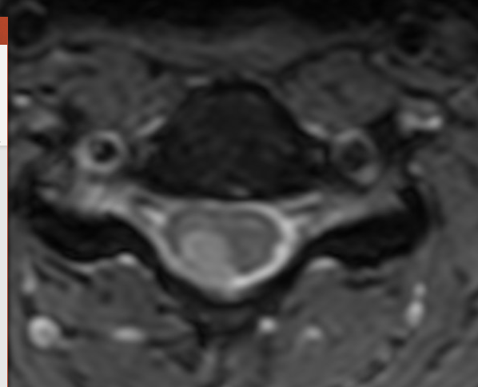
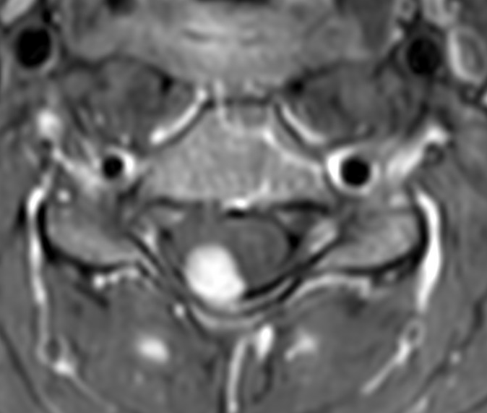
INTRAmedullary tumors that are typically EXTRAmedullary
Intramedullary Meningioma
Typical spinal meningiomas are intradural-extramedullary lesions with or without extradural extension, most frequently located in the thoracic spine [6].
Complete intramedullary meningiomas (IM) are extremely rare lesions with only a few reported cases [7]. They tend to occur in patients a little younger than typical intradural-extramedullary meningiomas, with preferential involvement of the upper cervical spine [7].
MRI features: most lesions are iso-hyperintense relative to the spinal cord on both T1- and T2-weighted images, with homogenous enhancement after gadolinium. The enhancement pattern of IM resembles typical meningiomas. (Fig 2).
Intramedullary tumoral lesions of the cervical spine with homogeneous enhancement pattern like that of typical meningiomas.
Fig 2. Intramedullary Meningioma

Slide 9
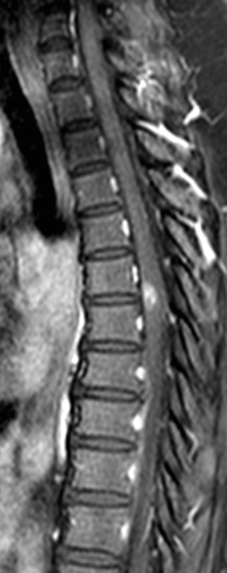
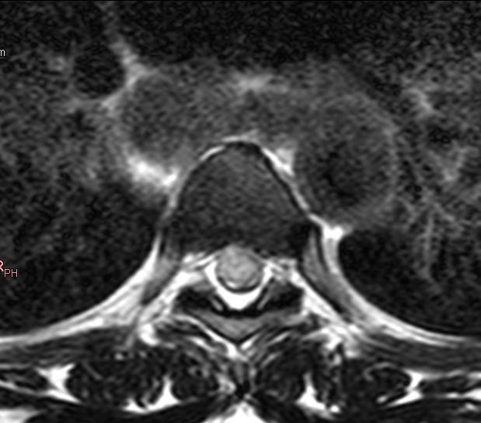
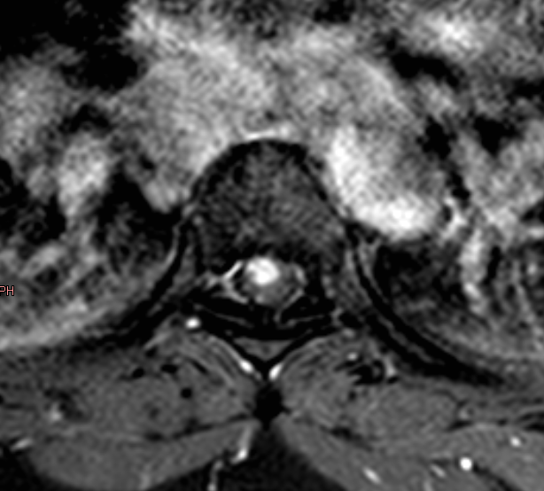
INTRAmedullary metastases. These are more commonly found in BONE structures
Intramedullary Spinal Cord Metastases
Intramedullary spinal cord metastases (ISCM) is uncommon, but it is being increasingly diagnosed, related to the advance in imaging methods and cancer therapies, allowing longer survival for cancer patients [9]. Lung and breast neoplasms are the most common primary malignancies [9,10].
Hematogenous, leptomeningeal and direct invasion of contiguous structures are the most common dissemination routes [9].
The thoracic segment was most involved, followed by cervical, lumbar level and conus medullaris [9, 10].
MRI features: most lesions are solitary, eccentrically located in spinal cord, promoting cord expansion, T1-isointense and T2-hyperintense relative to the cord and enhancing after GD [10]. (Fig 3).
The length of T2 signal abnormality in spinal cord is often more extensive than the length of the enhancing lesion, suggesting edema.
Fig 3. Intramedullary Spinal Cord Metastases

Slide 10
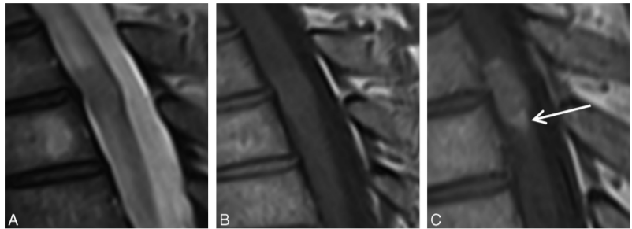
INTRAmedullary metastases. These are more commonly found in BONE structures
Intramedullary Spinal Cord Metastases
Virtually all intramedullary spinal cord metastases (ISCM) enhance after contrast, mostly with avid enhancement.
Two peripheral enhancement patterns have been described as a helpful MRI sign of spinal cord metastasis, compared with primary spinal cord tumor (e.g., ependymoma and astrocytoma): a more intense thin rim of peripheral enhancement around an enhancing lesion (rim sign) and ill-defined enhancement extending above and/or below the lesion (flame sign) [11].
It has been reported that in 90% of studies of patients who have spinal cord metastases one or both of the rim and flame sign are present and that this finding is fairly specific [11].
Intratumoral hemorrhage and intra/peritumoral cystic/necrotic change are rare [10]. Additional CNS/spinal metastases are extremely common. Look at for it!
Flame sign. Sagittal T2-weighted (A), T1-weighted (B), and postcontrast T1-weighted (C) images. Note the flame sign (arrow, C): an ill-defined flame-shaped region of enhancement at the inferior margin of the defined mass.
Extensive edema compared to a small enhancing lesion allows including ISCM as a differential diagnosis between intramedullary tumors. Look at for rim and flame signs!
Rim sign. Sagittal T2-weighted (A), T1-weighted (B) and postcontrast T1-weighted (C). Note the rim sign (arrows, D): an enhancing intramedullary mass with a thin rim of more intense enhancement.
Rykken JB, Diehn FE, Hunt CH, Eckel LJ, et al. Rim and flame signs: post gadolinium MRI findings specific for non-CNS intramedullary spinal cord metastases.
AJNR Am J Neuroradiol. 2013

Slide 11
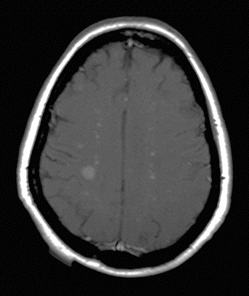
INTRAmedullary metastases. These are more commonly found in BONE structures
Conus Medullaris Metastases
Most common tumoral conus medullaris lesions comprehend astrocytomas and ependymomas, specially mixopapillary epedymomas [13].
ISCM are uncommon and incidence of metastases to the conus medullaris is still more rare with only a few reports. MRI features are like other ISCM. Distinction of mixopapillary epedymomas: ISCM are usually smaller, with medullar edema and less spinal cord expansion and usually do not expand the spinal canal or cause scalloping of the vertebral bodies. (Fig 4).
Myxopapillary ependymoma: most commonly present in young adult males, marked homogeneous enhancement is typical, often have associated hemorrhage; may calcify or undergo cystic degeneration, if large, may expand the spinal canal, cause scalloping of the vertebral bodies and extend out of the neural exit foramina.
Brain metastases associated
ISCM are usually smaller, with medullar edema and less spinal cord expansion and usually do not expand the spinal canal or cause scalloping of the vertebral bodies.
Fig 4. Conus medullaris and brain metastases

Slide 12
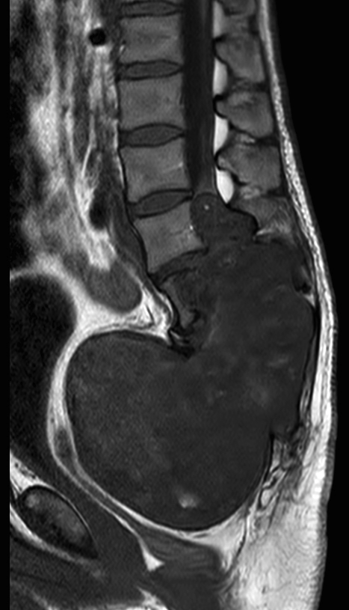
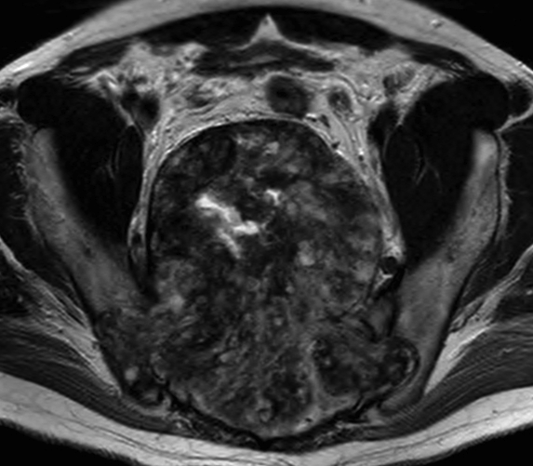
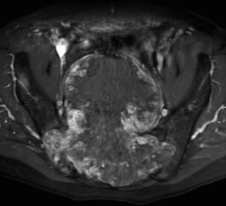
GIANT tumors that are generally smaller and without bone involvement
Giant Myxopapillary Ependymoma (GME)
Myxopapillary ependymomas are a variant type of ependymoma that occurs predominantly in the filum terminale and/or conus medullaris [13]. The vast majority are intradural and extramedullary spinal tumors. Classically, they are lobulated sausage-shaped masses, with or without posterior vertebral bodies scalloping or extension outside the neural exit foramen.
GME are rare tumors, usually intradural with destructive extension to the sacral region, making difficult to determine whether the tumor has an intra or extradural origin. Extradural myxopapillary ependymomas are even rarer, probably resulting from extradural remnants of the filum terminale or coccygeal medullary vestige [14] .
MRI features: they are typically isointense relative to the spinal cord and roots on T1-weighted images and hyperintense on T2WI. Occasionally, may be hyperintense on unenhanced T1-weighted images due to proteinaceous mucoid matrix or hypointense on T2W due hemorrhage. Virtually, all lesions enhance with contrast administration (usually homogeneous but may be heterogeneous when hemorrhage or necrosis is present). (Fig.5). Differential diagnosis: aneurysmal bone cyst, chordoma, giant cell tumor.
Myxopapillary ependymomas are the most hemorrhage-related subtype of ependymomas. Hyperintense lesions on unenhanced T1-weighted images may be useful in distinguishing myxopapillary ependymomas from other ependymoma subtypes.
Fig 5. Giant Myxopapillary Ependymoma

Slide 13
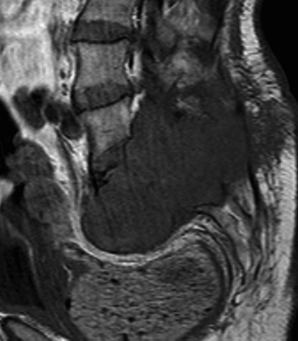
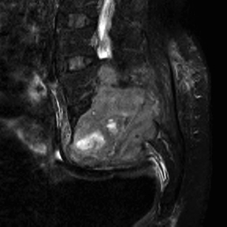
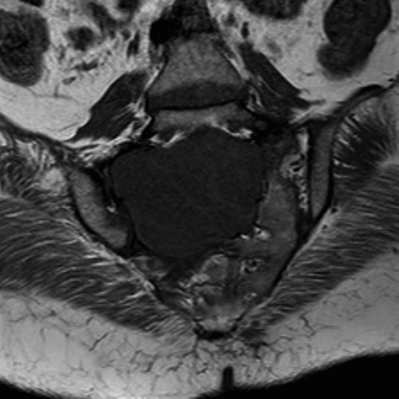
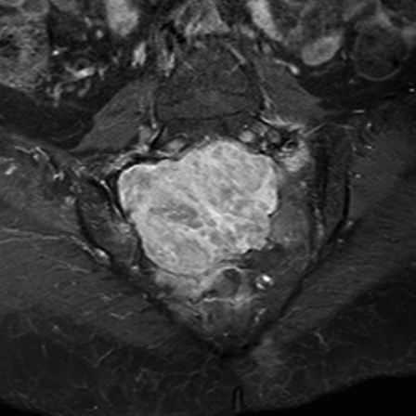
GIANT tumors that are generally smaller and without bone involvement
Giant Sacral Schwannoma (GSS)
Spinal schwannomas are benign nerve sheath tumors within the spinal canal, tipically arising from spinal nerve roots and they are the most common nerve sheath tumor of spine. The vast majority are intradural and extramedullary spinal tumors [14] and they are rarely seen in the sacral region (1-5% of all spinal schwannomas) [16].
In general, they appear as solid, well-defined, encapsulated lesions, often with associated adjacent bony remodeling. Large lesions may protrude out of the neural foramen, forming a classic dumbbell-shaped mass. Typical schwannomas usually are isointense to the muscle on T1-weighted sequences, heterogenous hyperintense on T2WI, with intense heterogenous contrast enhancement. Hemorrhage, vascular changes and cysts are frequent, specially in large lesions [17].
GSSs are defined as lesions that extend over more than two vertebral levels, have an extraspinal extension of more than 2.5 cm or erode the vertebral bodies and extend posteriorly and laterally into the myofascial planes (giant invasive tumors) [18, 19] (Fig 6). They are usually slow growing lesions, with vague symptomatology until reach large size. Pelvic MRI is important because it demonstrates tumor size, localization and its relationship with other intrapelvic organs for surgical planning.
There are no specific radiological features associated with GSS, but some findings are suggestive: a well-demarcated round mass isointense on T1W and hyperintense on T2W images, with heterogeneous contrast enhancement due to cystic /necrotic or haemorrhagic changes; located in the region of a known nerve ganglion.
Fig 6. Giant Sacral Schwannoma

Slide 14
Spinal astrocytomas exhibiting heterogeneous signal and cystic component. Emblematic findings that are usually observed in ependymomas.
Astrocytoma Grade I
Primary intramedullary tumors are usually derived from neuroepithelial tissue, especially glial cells, where ependymoma and astrocytoma constitute up to 70% of spinal cord tumors [20].
Astrocytomas are the most common spine tumors in children and occur in the thoracic region, followed by the cervical and lumbar region. They arise from cord parenchyma and usually have an eccentric location within the spinal cord. They usually are infiltrative with poorly defined margins. Peritumoral edema and intratumoral/polar cysts are present in a small percentage unlike ependymomas, and hemorrhage is uncommon [20].
Pilocytic astrocytomas (Grade I) have more specific features and are almost always well-defined and tend to displace rather than infiltrate the cord. Associated cysts and syringomyelia are more common.
Ependymomas are the most common intramedullary lesion in adults. The classic MRI features are an enhancing mass with well-defined margins, which expands outward from the ependymal lining of the central canal and is more centered in spine cord. The lesions are usually hypointense to isointense on T1W, hyperintense on T2W and heterogenous with cystic or hemorrhagic components, including polar cysts or the hemosiderin cap sign at the superior or inferior margins. Surrounding edema and syringohydromyelia are frequent [20].
Fig 7. Astrocytoma Grade I exhibiting heterogeneous signal and cystic component (red arrows)

Slide 15
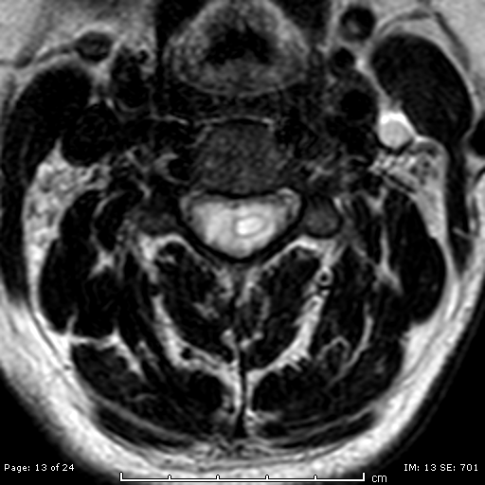
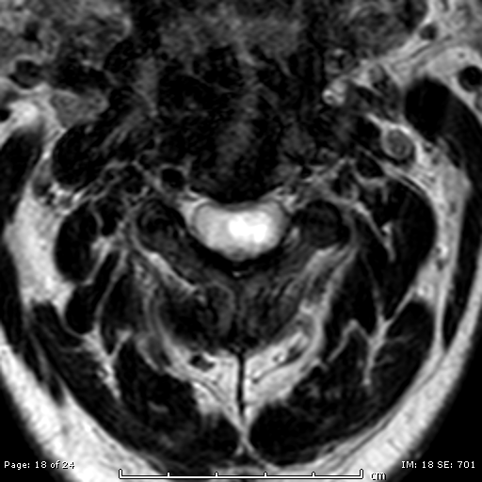
Spinal astrocytomas exhibiting heterogeneous signal and cystic component. Emblematic findings that are usually observed in ependymomas.
Grade II IDH mutant Diffuse Astrocytoma
Although MRI features can help differentiate between Astrocytomas and Ependymonas, their features are often overlapping and differentiation between them based on imaging remains difficult.
Large Astrocytomas due to their infiltrative patter can present central location in spine cord and heterogenous appearance, with cystic changes, hemorrhage and variable enhancement patterns [20]. (Fig 7 and 8).
Although they are not specific characteristics, Kim et al found that the presence of syringohydromyelia was the only significant factor that distinguishes ependymoma from astrocytoma. They also found that most of the tumoral haemorrhages seen were demonstrated as cap signs, related to ependymomas [21].
Presence of syringohydromyelia and tumoral haemorrhages are usually related to ependymomas, but large astrocytomas may have heterogenous appearance, with cystic and hemorrhage changes (Fig. 8).
Fig 8. Large Grade II IDH mutant Diffuse Astrocytoma exhibiting heterogeneous signal, hemorrhage (yellow arrow) and cystic appearance/syringohydromyelia (red arrows).

Slide 16
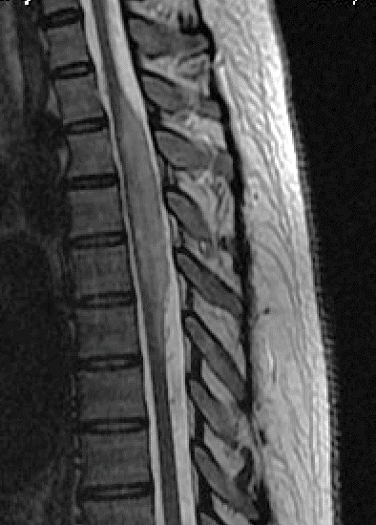
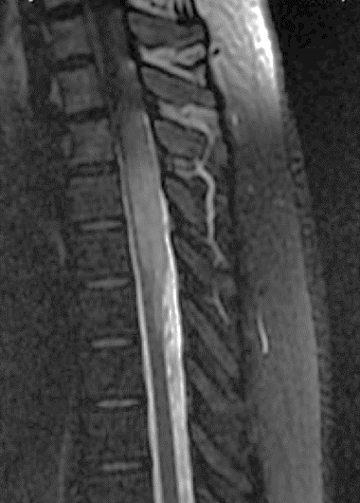
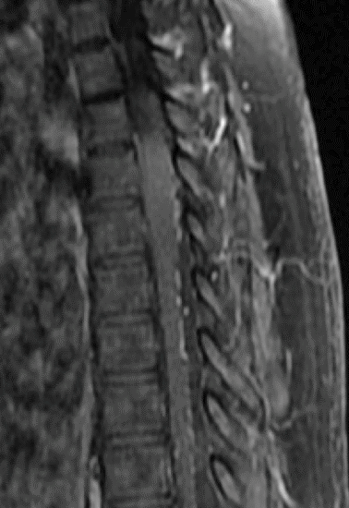
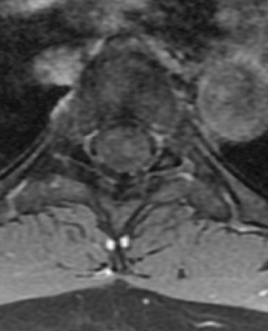
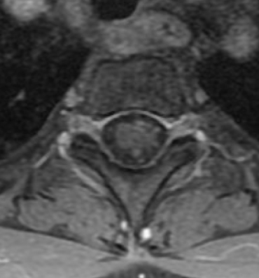
Typically involves long segments, have eccentric location and patchy enhancement
Intramedullary Ganglioglioma
Spinal gangliogliomas are rare intramedullary lesions, more frequent in children and young adults [22].
They are typically slow growing and low grade (I/II) lesions but have a high likelihood of local recurrence[23]. Most frequently involves the cervical cord, followed by thoracic and lumbar spine and the entire length of the spinal cord (holocord).
They are typically eccentric and involve long segments of the spinal cord (Fig 9). On imaging, scoliosis and bone remodeling are common but nonspecific findings [23].
MRI features: Usually circumscribed solid or mixed solid and cystic mass occupying a long segment of the spinal cord, hypointense on T1W, hyperintense T2W with variable enhancement patterns, from absent to marked [22]. Calcification may be present but is less common than in intracranial gangliogliomas.
They can present mixed signal intensity on T1W MR images due to the dual cellular elements of the tumor (glial and neural) and is a very specific characteristic among spine cord tumors.
Fig 9. Intramedullary Ganglioglioma exhibiting eccentric location (red arrows) and involving long segment of the spinal cord (yellow circle)

Slide 17
Habitually involves bone structures
Intradural Chordoma
Chordoma is a low-grade malignant bone tumor derived from embryonic notochord remnants along the axial skeleton, mainly in sacrococcygeal region and skull base. Most chordomas are extradural, infiltrative and cause extensive bone destruction.
Intradural chordomas are uncommon lesions and mostly intracranial located, especially the prepontine region. Spinal chordomas without bone involvement are extremely rare with only a few case reports.
Generally, intradural chordomas have better prognosis than typical chordomas [24] due to their circumscribed margins and the absence of bone involvement allowing for total resection.
Due to its intradural location and circumscribed aspect, it is difficult to distinguish an Intradural chordoma from a neurogenic tumor by imaging, specially when the lesion is dumbbell-shaped. (Fig 10)
Intradural location and circumscribed aspect (sometimes dumbbell-shaped) making hard the differential diagnosis with neurogenic tumor.
Fig 10. Intradural Chordoma

Slide 18
Algoritm/Conclusion
After this presentation, radiologists should keep in mind that spinal tumors may present atypically, involving unexpected compartments and, therefore, it is necessary to know unusual differential diagnoses in order to better management of the patients.
Although the MRI findings are not specific, some features can be highlighted as differentials:
Intramedullary Schwannomas: Look at for a predominant extramedullary component or intramedullary tumor continuity with a thickened spinal nerve root.
Intramedullary Meningioma: Lesions with homogeneous enhancement pattern like to that of typical meningiomas in cervical spine.
Intramedullary Metastasis: Small enhancing lesions with extensive cord edema. Look at for ring and flame signs.
Primary intramedullary tumors: Keep in mind that ependymomas and astrocytomas have overlapping features, but the cap sign and syringohydromyelia can help the differential. Think about ganglioglioma in a presence of a circumscribed mass occupying a long segment of the cord in a child, specially if present mixed signal intensity on T1-weigthed MR images.
Intradural chordomas: Although extremely rare, remember that intradural chordomas may mimic neural sheath tumors

Slide 19
References
1. Engelhart HH, Villano JL, Porter KR, et al. Clinical presentation, histology, and treatment in 430 patients with primary tumors of the spinal cord, spinal meninges, or caude equina. J Neurosurg Spine. 2010;13:67–77.
2. Van Goethem JW, van den Hauwe L, Ozsarlak O, De Schepper AM, Parizel PM. Spinal tumors. Eur J Radiol. 2004 May;50(2):159-76.
3. Gupta A, Nair BR, Chacko G, Mani S, Joseph V. Cervical intramedullary schwannoma mimicking a glioma. Asian J Neurosurg. 2015;10(1):42-44.
4. Kodama Y, Terae S, Hida K, Chu BC, Kaneko K, Miyasaka K. Intramedullary schwannoma of the spinal cord: Report of two cases. Neuroradiology. 2001;43:567–71.
5. Colosimo C, Cerase A, Denaro L, Maira G, Greco R. Magnetic resonance imaging of intramedullary spinal cord schwannomas. Report of two cases and review of the literature. J Neurosurg. 2003 Jul;99(1 Suppl):114-7.
6. Koeller KK, Shih RY. Intradural Extramedullary Spinal Neoplasms: Radiologic-Pathologic Correlation. Radiographics. 2019 Mar-Apr;39(2):468-490.
7. Yuan D, Liu D, Yuan XR, Xi J, Ding XP. Intramedullary thoracic spinal cord meningioma: a rare case report and review of the literature. J Neurol Surg A Cent Eur Neurosurg. 2013 Dec;74 Suppl 1:e136-9.
8. Salehpour, F., Zeinali, A., Vahedi, P. et al. A rare case of intramedullary cervical spinal cord meningioma and review of the literature. Spinal Cord 46, 648–650 (2008).
Lv J, Liu B, Quan X, Li C, Dong L, Liu M. Intramedullary spinal cord metastasis in malignancies: an institutional analysis and review. Onco Targets Ther. 2019;12:4741-4753.
10. Rykken JB, Diehn FE, Hunt CH, Schwartz KM, Eckel LJ, Wood CP, Kaufmann TJ, Lingineni RK, Carter RE, Wald JT. Intramedullary spinal cord metastases: MRI and relevant clinical features from a 13-year institutional case series. AJNR Am J Neuroradiol. 2013 Oct;34(10):2043-9. doi: 10.3174/ajnr.A3526.
11. Rykken JB, Diehn FE, Hunt CH, Eckel LJ, Schwartz KM, Kaufmann TJ, Wald JT, Giannini C, Wood CP. Rim and flame signs: postgadolinium MRI findings specific for non-CNS intramedullary spinal cord metastases. AJNR Am J Neuroradiol. 2013 Apr;34(4):908-15. doi: 10.3174/ajnr.A3292.
12. Dam-Hieu P, Seizeur R, Mineo JF, Metges JP, Meriot P, Simon H. Retrospective study of 19 patients with intramedullary spinal cord metastasis. Clin Neurol Neurosurg. 2009 Jan;111(1):10-7. doi: 10.1016/j.clineuro.2008.06.019. Epub 2008 Oct 19. PMID: 18930587.oethem JW, van den Hauwe L, Ozsarlak O, De Schepper AM, Parizel PM. Spinal tumors. Eur J Radiol. 2004 May;50(2):159-76.
13. Koeller KK, Rosenblum RS, Morrison AL. Neoplasms of the spinal cord and filum terminale: radiologic-pathologic correlation. Radiographics. 2000 Nov-Dec;20(6):1721-49.
14. Quraishi NA, Wolinsky JP, Bydon A, Witham T, Gokaslan ZL. Giant destructive myxopapillary ependymomas of the sacrum. J Neurosurg Spine. 2010 Feb;12(2):154-9.

Slide 20
References
15. Kahan H, Sklar EM, Post MJ et-al. MR characteristics of histopathologic subtypes of spinal ependymoma. AJNR Am J Neuroradiol. 1996;17 (1): 143-50.
16. Togral G, Arikan M, Hasturk AE, Gungor S. Incidentally diagnosed giant invasive sacral schwannoma. Its clinical features and surgical management without stability. Neurosciences (Riyadh). 2014;19(3):224-228.
17. Nguyen TKL, Vo NQ, Ngo DHA, Le TB, Nguyen TM, Nguyen Thanh T. Giant lumbar spinal schwannoma: a case report and literature review. Radiol Case Rep. 2021 Jul 1;16(9):2388-2392.
18. Sridhar K, Ramamurthi R, Vasudevan MC, Ramamurthi B. Giant invasive spinal schwannomas: definition and surgical management. J Neurosurg. 2001 Apr;94(2 Suppl):210-5.
19. Klimo P Jr, Rao G, Schmidt RH, Schmidt MH. Nerve sheath tumors involving the sacrum. Case report and classification scheme. Neurosurg Focus. 2003 Aug 15;15(2):E12.
20. Shih RY, Koeller KK. Intramedullary Masses of the Spinal Cord: Radiologic-Pathologic Correlation. Radiographics. 2020 Jul-Aug;40(4):1125-1145.
21. Kim DH, Kim JH, Choi SH, Sohn CH, Yun TJ, Kim CH, Chang KH. Differentiation between intramedullary spinal ependymoma and astrocytoma: comparative MRI analysis. Clin Radiol. 2014 Jan;69(1):29-35.
22. Oppenheimer DC, Johnson MD, Judkins AR. Ganglioglioma of the Spinal Cord. J Clin Imaging Sci. 2015;5:53. Published 2015 Sep 30.
23. Smith AB, Soderlund KA, Rushing EJ, Smirniotopolous JG. Radiologic-pathologic correlation of pediatric and adolescent spinal neoplasms: Part 1, Intramedullary spinal neoplasms. AJR Am J Roentgenol. 2012 Jan;198(1):34-43.
24. Zhang, J., Gao, Cp., Liu, Xj. et al. Intradural cervical chordoma with diffuse spinal leptomeningeal spread: case report and review of the literature. Eur Spine J 27, 440–445 (2018).
25. Steenberghs J, Kiekens C, Menten J, Monstrey J. Intradural chordoma without bone involvement. Case report and review of the literature. J Neurosurg. 2002 Jul;97(1 Suppl):94-7.
Notes:
MEGASEIO DURAL – ANOAMLIA CONGENITA/CONSTITUCIONAL

